Slide 1


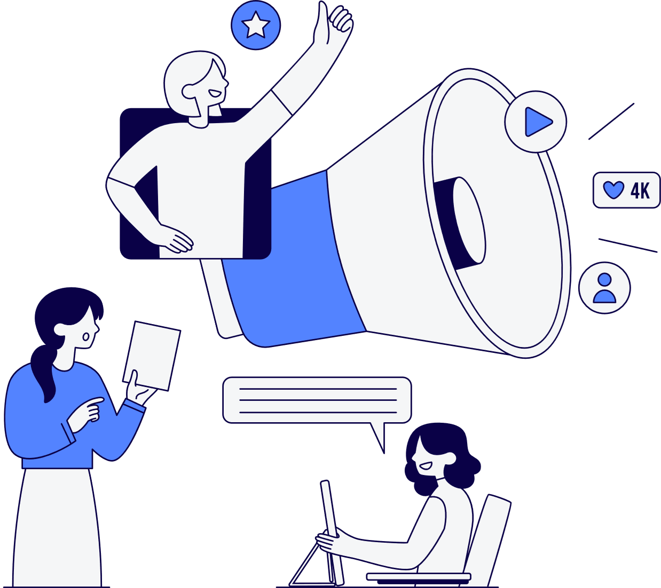

FitGenius ABOUT US CONTACT US
Project Requirements
FitGenuis
Team #3

Slide 2







FitGenius ABOUT US CONTACT US
Team Members
Project Lead
Mirna
Farahat
Arpa
Hakopian
Sergio Garcia
Isai
Flores
Emanuel
Diaz

Slide 3

FitGenius ABOUT US CONTACT US
01
Introduction

Slide 4
FitGenius ABOUT US CONTACT US
01
INTRODUCTION
Overview:
This presentation outlines the project requirements for developing an AI-powered fitness app
Focus on defining functional and non-functional requirements, defining stakeholders, establishing core features, and outlining specific objectives.

Slide 5
FitGenius ABOUT US CONTACT US
01
INTRODUCTION
Description:
This AI-powered fitness app generates personalized workout routines based on user data and goals, integrating tracking features and game-like rewards to keep users motivated. Avatar customization enhancing engagement and making fitness both interactive and enjoyable.

Slide 6

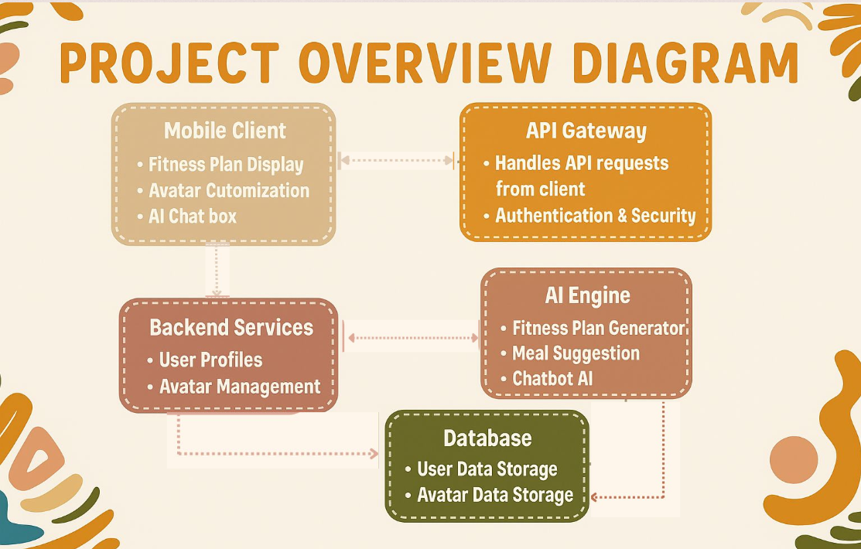


FitGenius ABOUT US CONTACT US

Slide 7
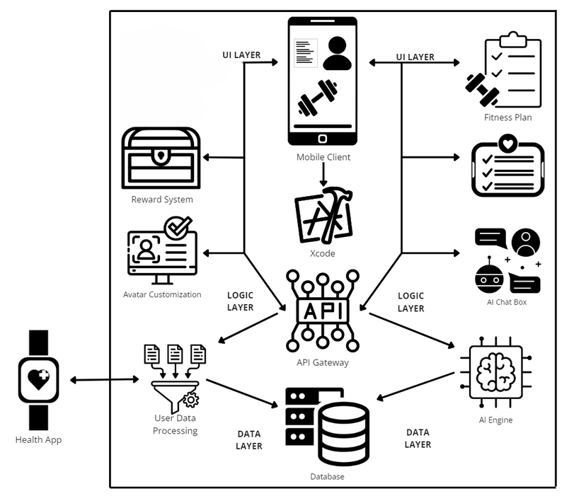
FitGenius ABOUT US CONTACT US
Project Overview Diagram
MEAL SUGGESTIONS

Slide 8
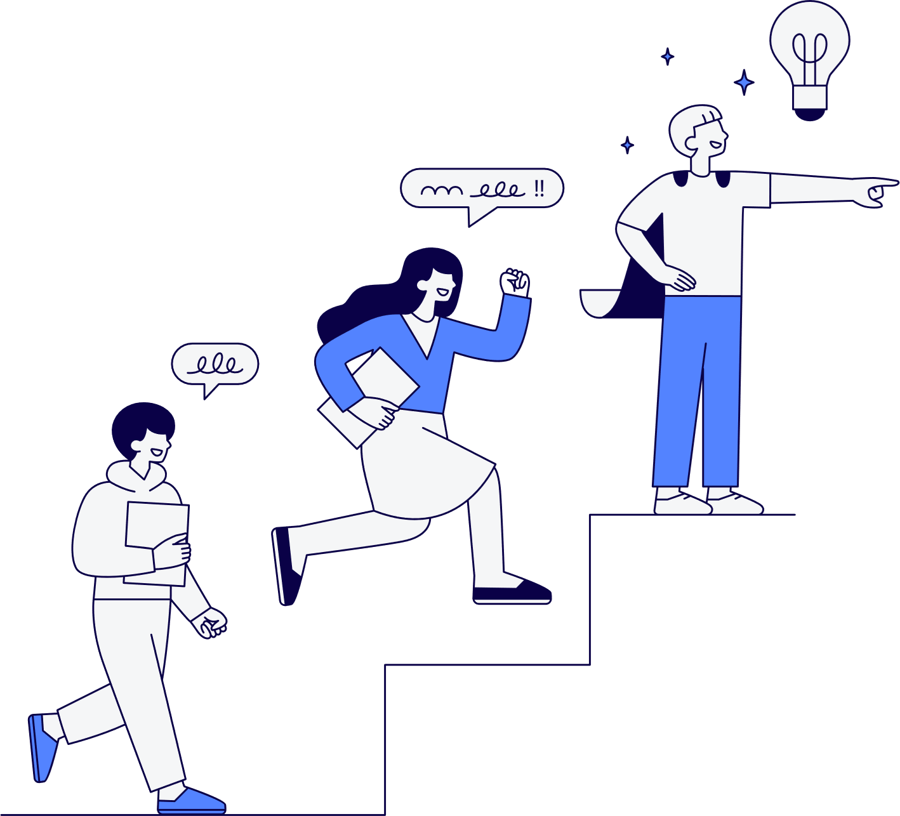
FitGenius ABOUT US CONTACT US
02
Stakeholders

Slide 9
FitGenius ABOUT US CONTACT US
02
Stakeholders
Users
People who will use FitGenius to track their nutrition and fitness goals. This group will include individuals who are looking to improve their diet/fitness and would benefit from features like workout tracking.
Development Team
The team of five working on FitGenius, who are in charge of learning the technologies involved, designing, coding, and maintaining the app.

Slide 10
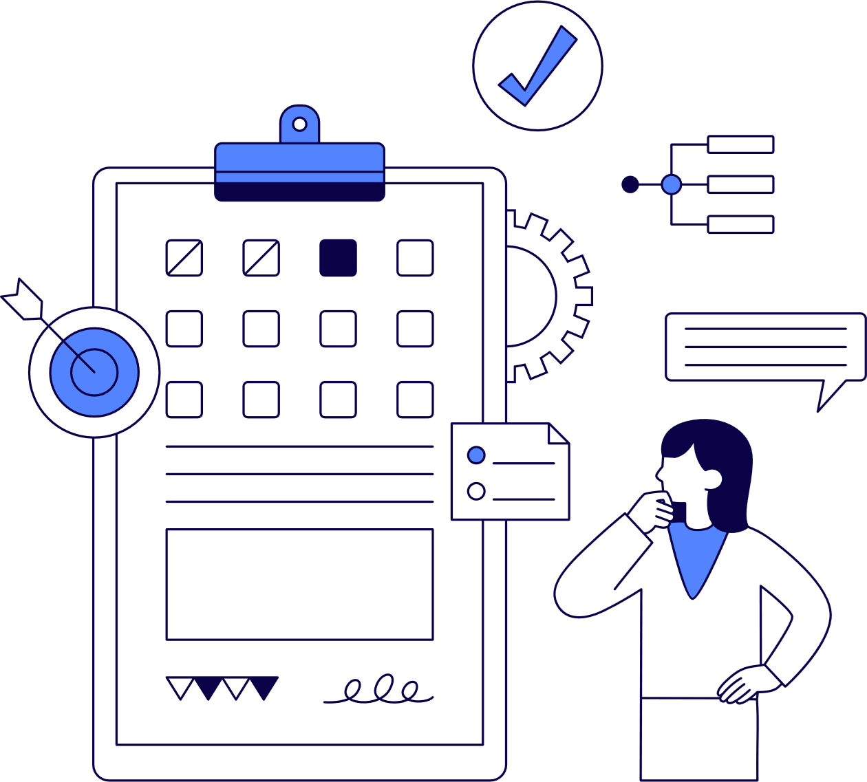
FitGenius ABOUT US CONTACT US
03
Functional Requirements

Slide 11
FitGenius ABOUT US CONTACT US
03
Functional Requirements
User Registration and Authentication
The app should:
allow users to register for an account with email
display error message when incorrect login information is inputted
retrieve existing user data from the Health app
ask users for information not provided by the health app

Slide 12
FitGenius ABOUT US CONTACT US
03
Functional Requirements
Profile Management
The app should:
allow users to change password
Send a verification email to the user before allowing password or contact information changes.
Allow users to make changes to collected health information
Allow users to update goals

Slide 13
FitGenius ABOUT US CONTACT US
03
Functional Requirements
Tracking
The app should:
allow users to log workouts
maintain timeline of activity with dates
allow users to view their tracked activity collected from the Health app
allow users to configure tracking preferences

Slide 14
FitGenius ABOUT US CONTACT US
03
Functional Requirements
AI Chat Box
The app should:
allow users to ask for specific workout plans
allow users to ask for specific meal ideas
intercept dangerous and unhealthy requests
offer users to adopt a suggested workout plan or not
transfer workout plan to in app schedule/log upon request
allow users to make manual adjustments to suggestd plans

Slide 15
FitGenius ABOUT US CONTACT US
03
Functional Requirements
Build Avatar
The app should:
allow users to build a custom avatar
guide users through a selection process of basic customization choices
allow users to edit their avatar at any time
unlock more customization options as users reach milestones
Newly unlocked accessories are highlighted in gold to notify users.

Slide 16
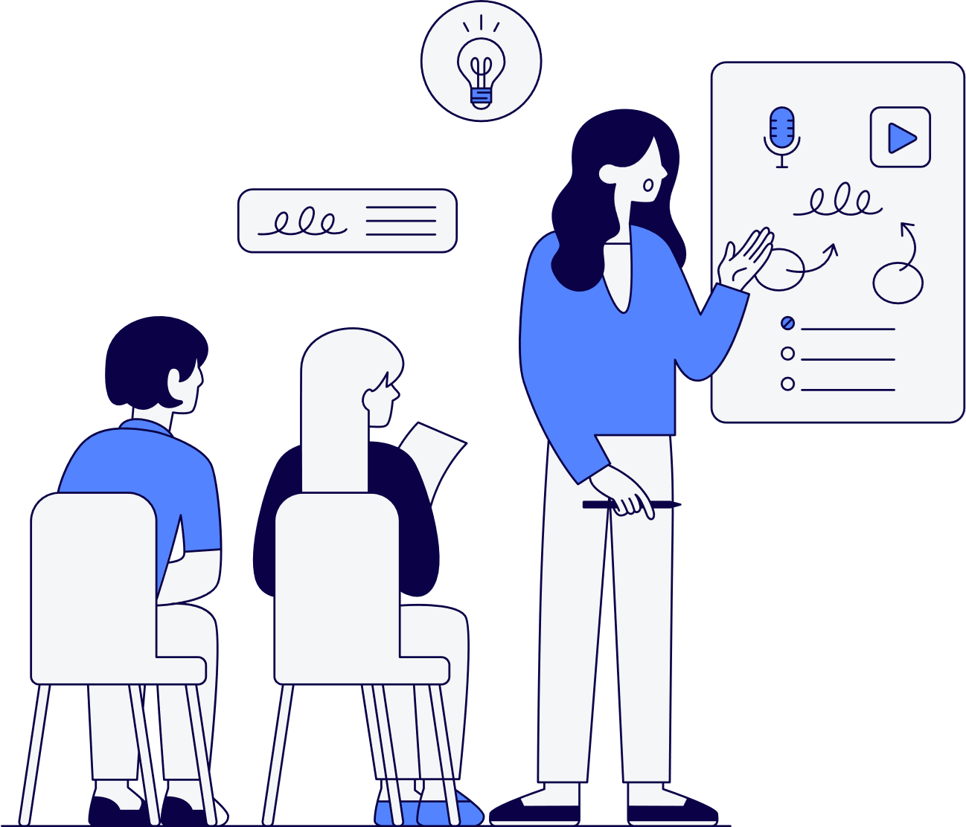
FitGenius ABOUT US CONTACT US
04
Non-Functional Requirements

Slide 17
FitGenius ABOUT US CONTACT US
04
Non-Functional Requirements
Security:
Implement data encryption (TLS) to protect user data
Use Firebase Authentication for secure email/password sign-ins
Performance:
Target an app launch time of 3-5 seconds, basic user interactions under 1 second, AI chat bot responses within 2-3 seconds
Perform stress tests on the core features of the app (startup, login, chatbot, etc..) to ensure that the response times meet expectations under the anticipated user load

Slide 18
FitGenius ABOUT US CONTACT US
04
Non-Functional Requirements
Usability:
Ensure that the app is easy to navigate with a clear layout following Apple’s Human Interface Guidelines
Space out buttons and make them large enough so that they are easily accessible
Reliability:
Target a 95% uptime and include error handling for common failures such as invalid inputs and server timeouts

Slide 19
FitGenius ABOUT US CONTACT US
04
Non-Functional Requirements
Scalability:
App will be designed initially to handle 100 concurrent users, with a flexible design to grow as demand increases
Use Firebase cloud service for data storage, which will automatically scale based on usage
Use Firebase automatic resource allocation and database scaling
Implement a modular design that can scale components individually

Slide 20
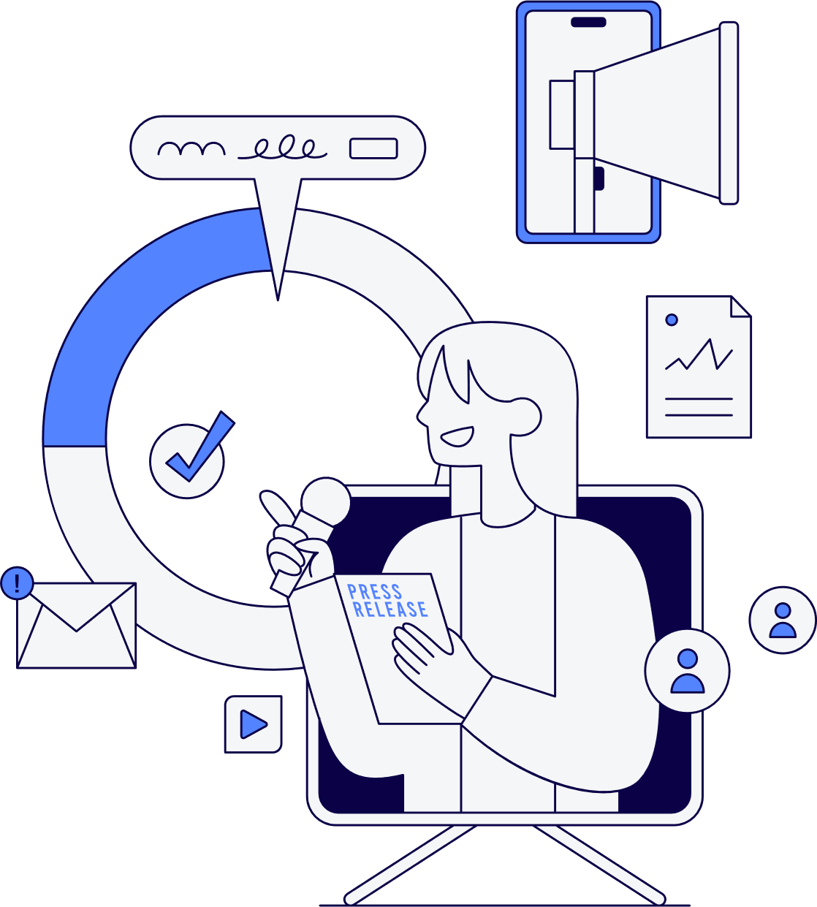
FitGenius ABOUT US CONTACT US
05
Use Cases /
User Stories

Slide 21
FitGenius ABOUT US CONTACT US
05
Use Cases /
User Stories
Use Case 1: User Registration and Avatar Creation
Story: As a new user, I want to register with my email and password, and create a personalized avatar that represents me on my profile, so that I can start tracking my fitness journey and engage with the app visually.

Slide 22
FitGenius ABOUT US CONTACT US
05
Use Cases /
User Stories
Use Case 2: AI-Generated Fitness Plans
Story: As a user, I want to input my fitness goals, workout preferences, and any injuries or disabilities I have, so that the AI chatbot can generate a customized fitness plan that caters to my needs.
Example: “I have 30 minutes, what’s a quick upper body workout that won’t strain my shoulder?”

Slide 23
FitGenius ABOUT US CONTACT US
05
Use Cases /
User Stories
Use Case 3: AI-Generated Meals/Recipes
Story: As a user, I want to input my dietary preferences and nutrition goals, so that the AI chatbot can recommend meals that help me meet those goals.
Example: “What’s a meal I can make that will help me reach my daily protein target of 120 grams?”

Slide 24
FitGenius ABOUT US CONTACT US
05
Use Cases /
User Stories
Use Case 4: Fitness Progress Tracking
Story: As a user, I want to track my workouts, steps, and progress toward my fitness goals, so that I can monitor my improvements over time and stay motivated.

Slide 25
FitGenius ABOUT US CONTACT US
05
Use Cases /
User Stories
Use Case 5: Personalized Avatars and Milestone Rewards
Story: As a user, I want to unlock avatar outfits and accessories when I reach fitness milestones, so that I can visually represent my achievements and stay motivated through gamification.
Example: "Unlock a new workout outfit when I complete my first 10K run."

Slide 26
FitGenius ABOUT US CONTACT US
05
Use Cases /
User Stories
Use Case 6: AI Chatbot for Safe and Accurate Fitness/Nutrition Advice
Story: As a user, I want the AI chatbot to provide medically accurate and safe fitness and nutrition advice, taking my personal boundaries and limitations into account, so that I can trust the recommendations and avoid injury.

Slide 27
FitGenius ABOUT US CONTACT US
05
Use Cases /
User Stories
Use Case 7: Data Security and Syncing
Story: As a user, I want my fitness data to be securely stored, so that I can access my progress anytime, anywhere, without worrying about data loss.
Use Case 8: Basic Analytics and Reporting
Story: As a user, I want to see analytics and reports on my fitness activities and nutrition habits, so that I can identify trends, adjust my plans, and optimize my performance.

Slide 28
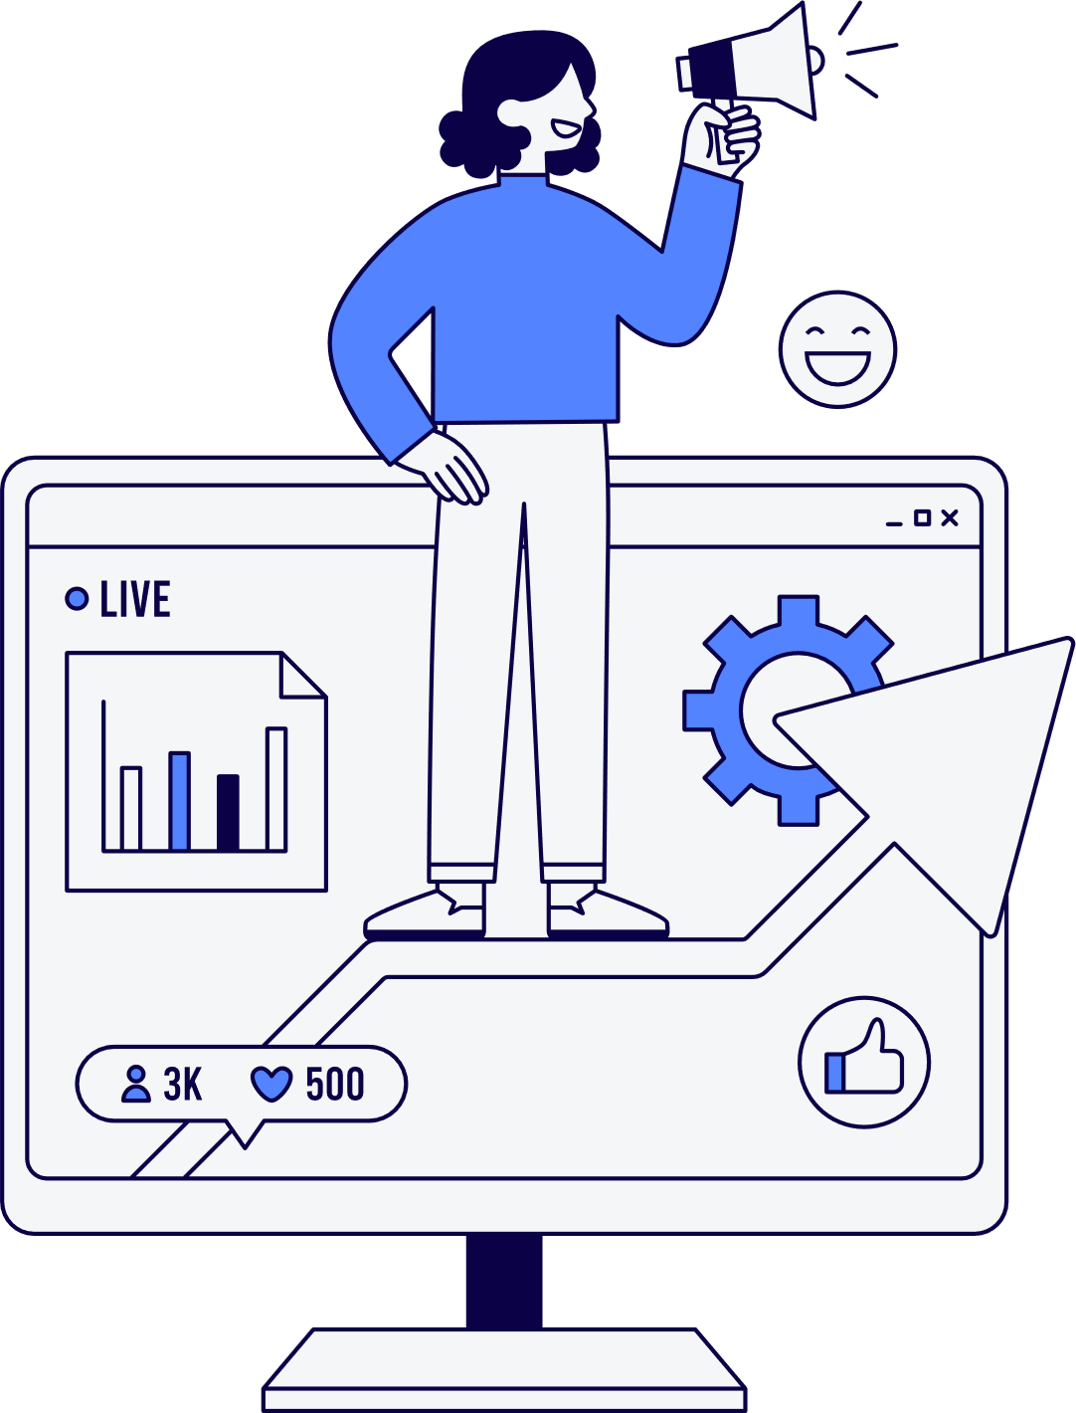
FitGenius ABOUT US CONTACT US
Thank You!
Any questions?

